Slide 1

Self-Driving RC Car using Lidar Technology to Map Environments
General Computing Project
John Robson

Slide 2
Background
During 2019-2020 there were a total of 1,580 road deaths that occurred in Great Britain, with 24,470 people being killed or seriously injured.
In 2018 a fatal accident occurred with an Uber Self-driving vehicle that collided with a pedestrian. Believed to have happened due to low lighting conditions affecting the system's performance.
Studies being performed by Intel showed that their "MobileEye" system itself was only able to detect the pedestrian in the dashcam footage 1 second before the accident happened.
There is still a flaw in the currently industry deployments of vehicle safety systems, which cause them to become unreliable in the dark.

Slide 3
How to solve this?
Light Detection and Range (LiDAR) sensors weren't utilized in these systems in the past due to their inherently high cost.
Low cost versions have been released that allow for 360’ scanning of a single 2D plane.
Because of this innovation, is this a suitable addition that could be added to vehicle systems?

Slide 4
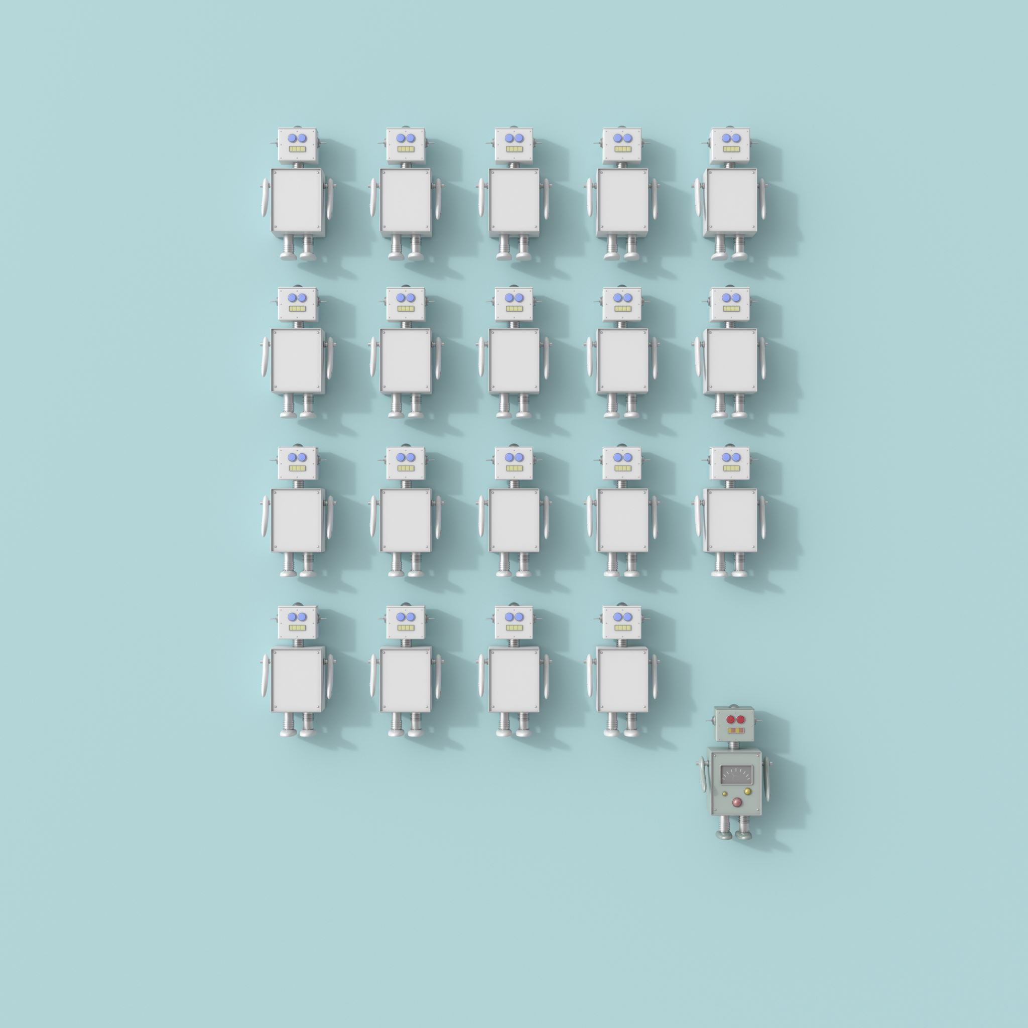
Research
LiDAR based robots are a well discussed area in literature.
Number of different techniques are used, both with physical prototype and simulated experiments.
Papers demonstrated systems with high levels of accuracy achieved but highlighted flaws with the sensor.
Limited environmental context can be derived from the information gathered by the LiDAR.
Only suitable for in specific cases.

Slide 5
Requirements
Information from research provided insight into what system requirements should be required.
Informed selections of parts were made to assist in creating a functional prototype.

Slide 6
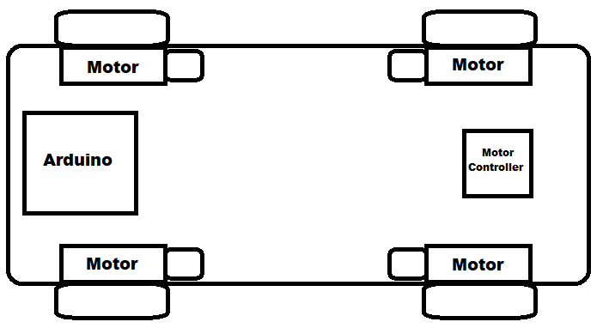
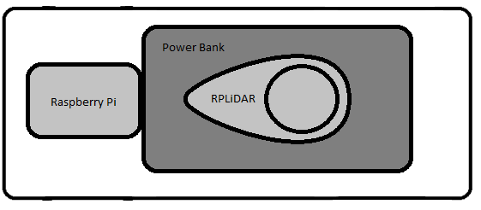
Design
Movement System
Designs were made for 2 platform levels.
The movement system handled converting instructions into motor activations.
Logic system handled data collection, filtering, and decision making.
Systems were designed separated due to the limited space available.
Logic System

Slide 7
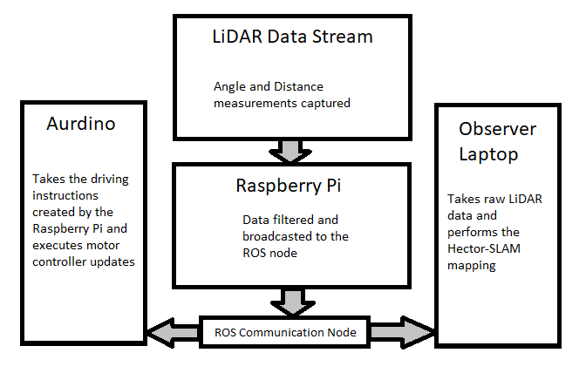
Prototype Communication
First implementation of the robotic operating system (ROS) was used in this project.
Understanding the flow of communication as important factor.

Slide 8
Implementation
Movement System
Low level design was first made to allow for component testing.
Allowed for communication instructions to be sent and received through the use of MQTT.
Demonstrated that the all parts were functional and could perform at adjusted speeds.

Slide 9
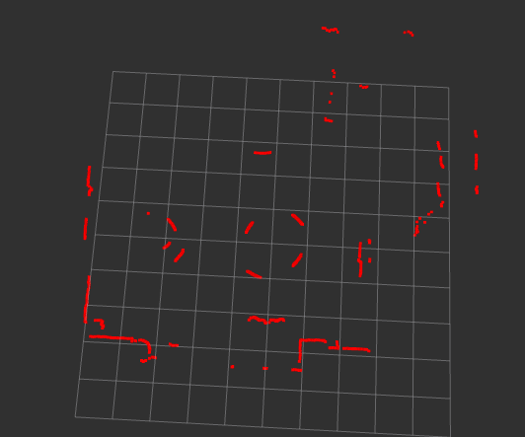
Logic System
None SLAM scan was taken of the lounge room to provide a visualisation of the room.
Showed that the logic system was capable of transmitting the data correctly.

Slide 10
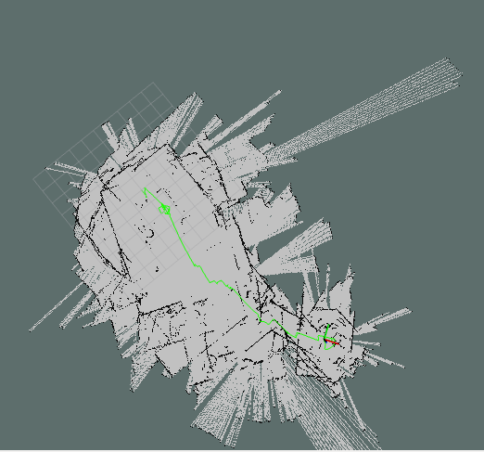
Combining the Systems
When combining the system, weight caused issues with turning speeds.
Because the speed was to high to allow the prototype to turn under the weight, SLAM scans were unintelligible.

Slide 11
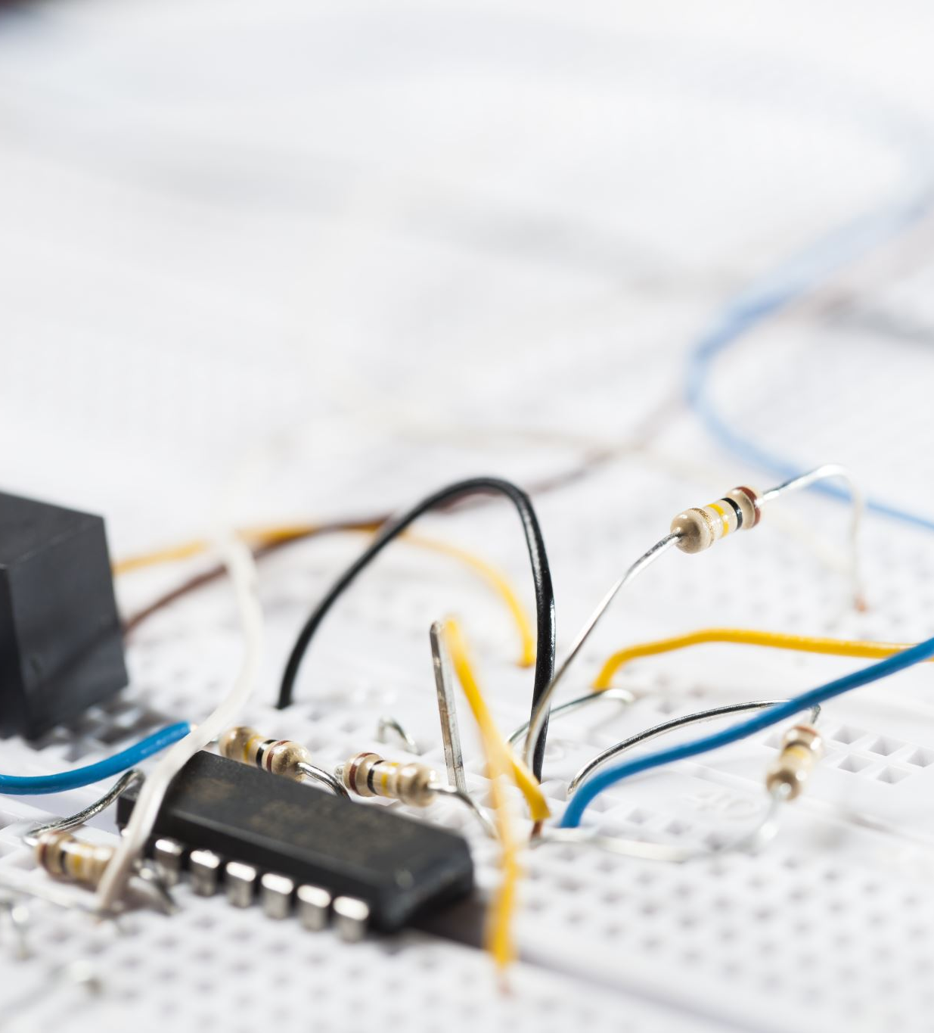
Testing
In isolation both systems functioned correctly, but due to the low torque of the motors and the increased weight of the power bank caused issues when merging.
To continue testing the logic system was used carried by hand to perform the test if the concept of the system was possible.

Slide 12
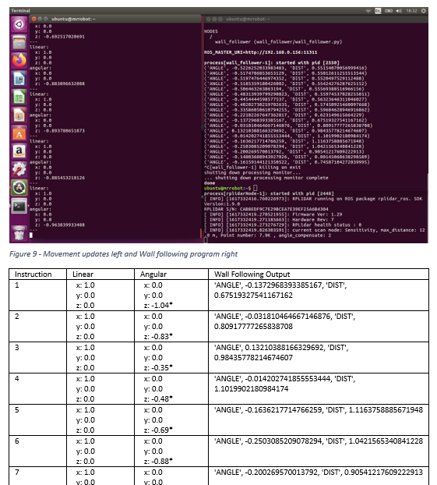
A review was performed during the carry test to see if the turn angle was updated.
This showed the wall follower pointing out the risk angel and the distance from the obstruction, as well as new movement instructions to avoid it.

Slide 13
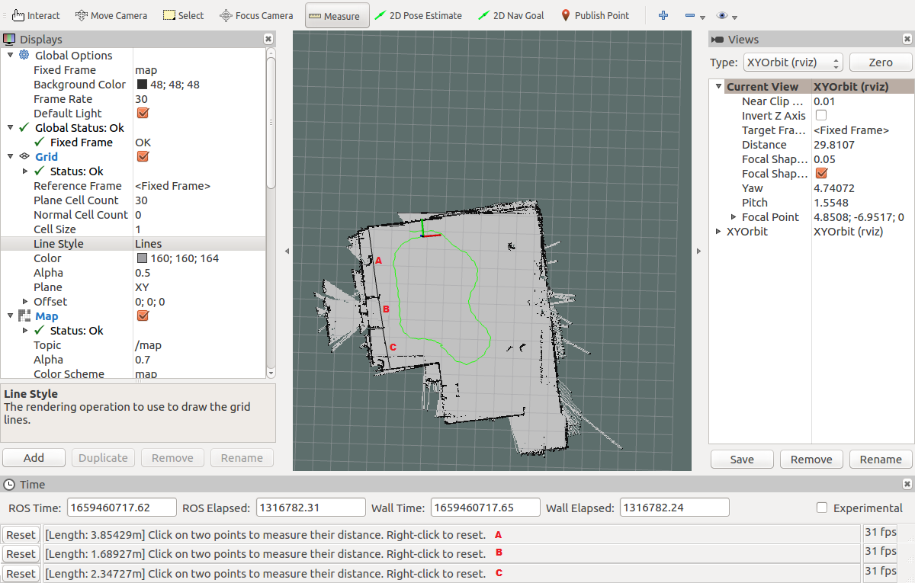
Physical measurements were taken of the lounge room as well as a successful SLAM map.
Difficult to precisely replicate the measurement angel on the map to that of the physical measurement.,
Comparing the measurements showed that the map was accurate with a error rate of 3.64%.
Points | Tape Measure Measurement | LiDAR Measurement | Measurement Error
A | 3.86m | 3.85m | 0.26%
B | 1.62m | 1.68m | 3.64%
C | 2.37m | 2.34m | 1.27%

Slide 14
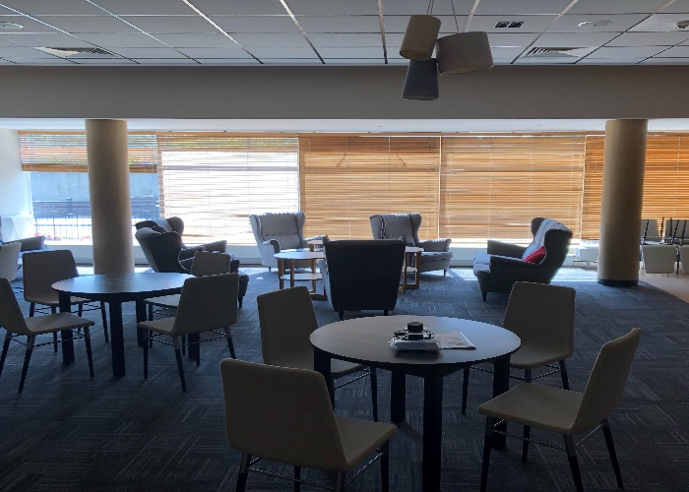
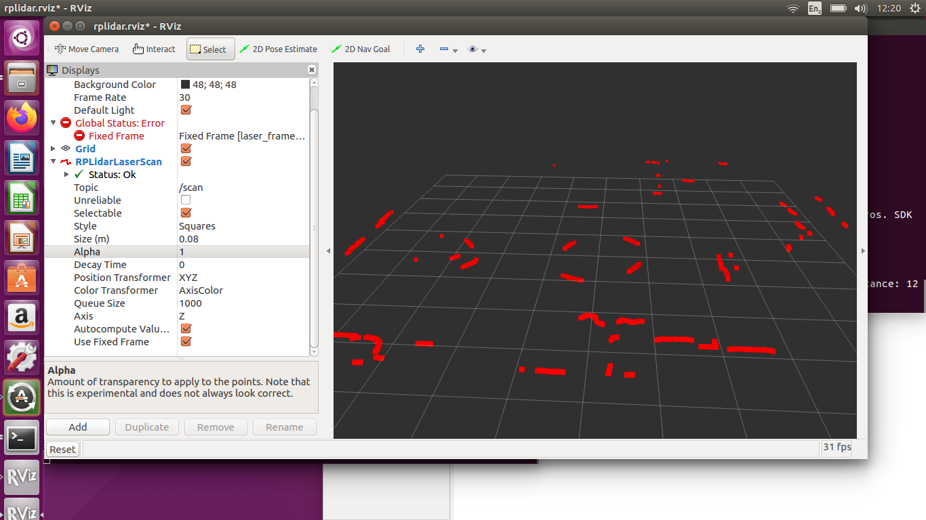
Testing was performed in the lounge room with different variations of lighting.
Difficulty in ranging objects in highly light areas.

Slide 15
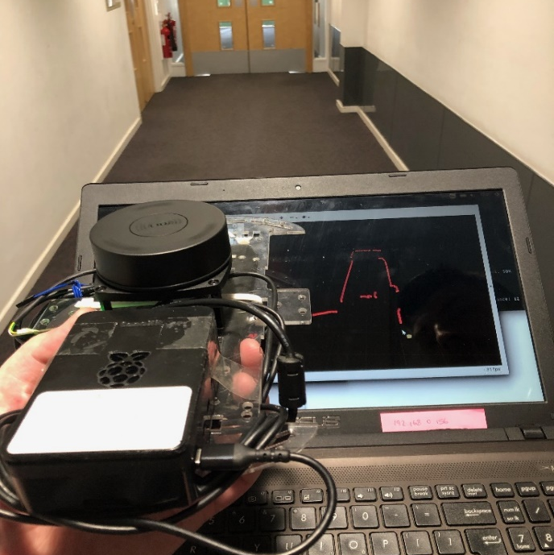
Prototype worked well in both natural light and artificial light locations.
Was able to remove temporary obstructions from maps.
Movement instructions did not ignore temporary obstructions.

Slide 16
Skills Gained
Serial and Network Communication Architectures
Power distribution
Design Process
SLAM techniques
Problem Solving
Identifying Technical Limitation
ROS deployment
C programming

Slide 17
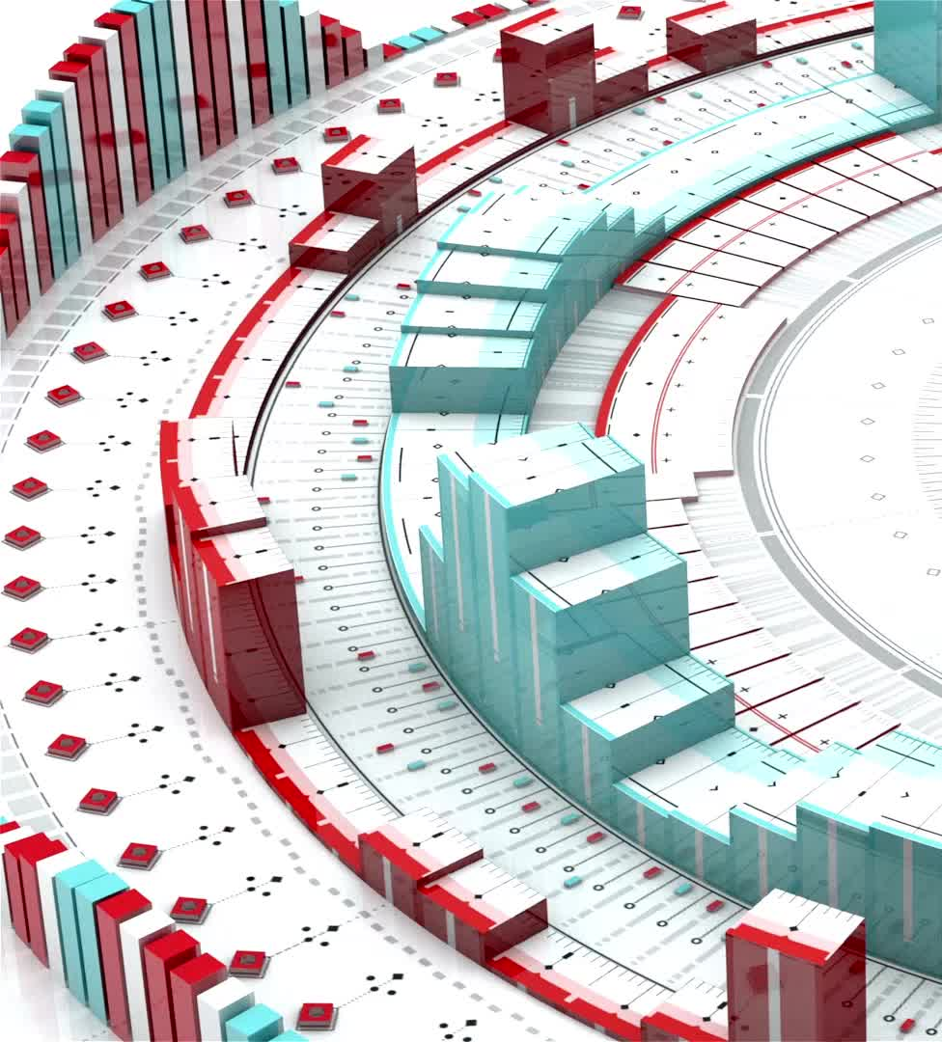
Conclusion
LiDAR is capable of performing accurate scans in various lighting conditions with less than 4% measurement error.
Can perform live movement corrections.
Lightweight enough to perform on limited IoT technology.
Create SLAM maps live with low latency.
Prototype was able identify and produce movement updates to avoid obstructions.

Slide 18
Future Work
ROS 2 applications
Higher Performance LiDAR (Higher Frequency, Stronger Laser)
3D lidar for greater Field of View
Evaluation of alternative SLAM techniques with the same hardware to identify the best performing for this setup.

